Slide 1
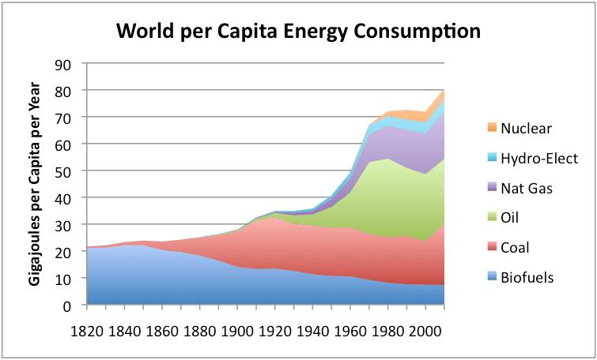
Energy Consumption since 1820
gailtheactuary.files.wordpress.com

Slide 2
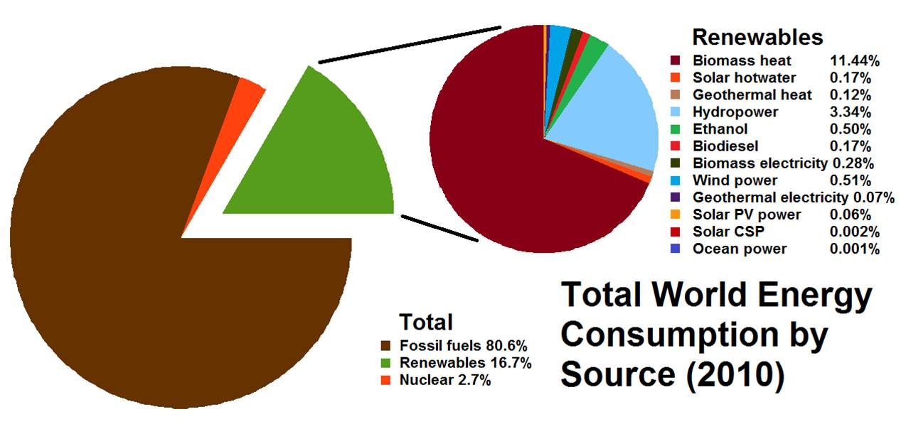
World Energy 2010
Notes:
Solar CSP = Concentrated solar power (Mirrors or lenses used to heat something).

Slide 3
Wind Power Facts
http://science.howstuffworks.com
One of the Oldest Forms of Energy
Wind Power is Solar Power
Wind Farms Pose no Threat to Birds (NSA 2007)
US Wind Turbines Could Power Colorado as of 2008
1.9 % of U.S. Electricity Production in 2009
38 US States Have Wind Farms
World Wind Power 4x higher, 2000 to 2006
Notes:
NSA = National Research Council – As long as they are properly sited
1 MW Wind Energy = 2,600 Fewer Tons CO₂
US Wind Could Power Nation 10x Over
Texas: Most Installed Wind Capacity of US States

Slide 4
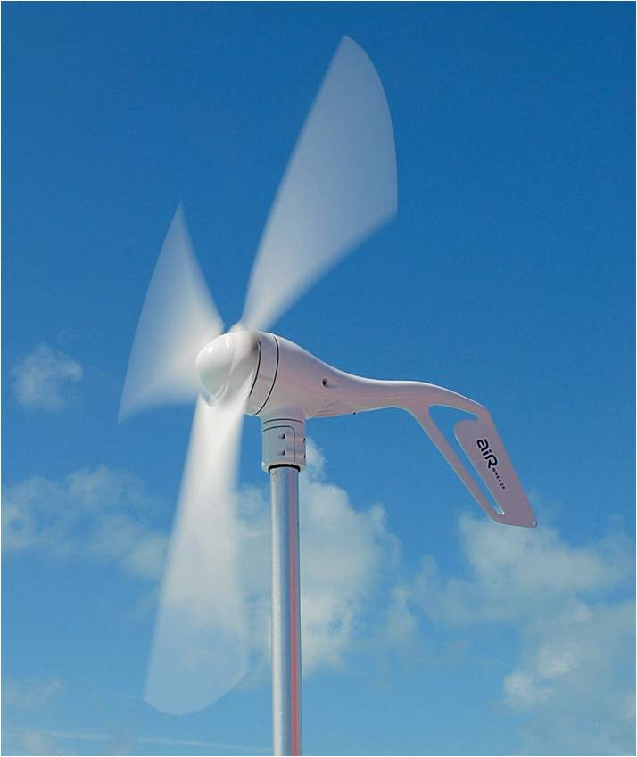
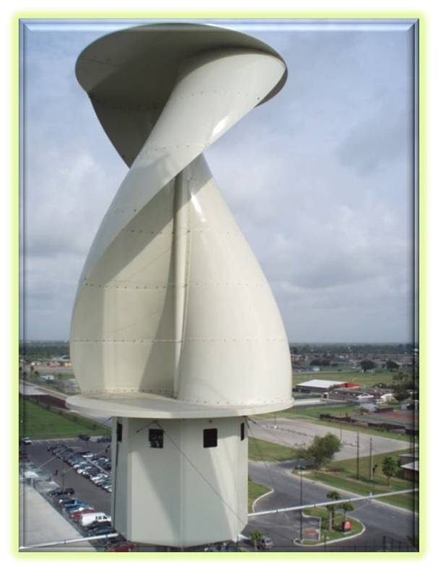
Turbine Types
Windy II Vertical Axis Wind Turbine
windturbinezone.com
www.darcorp.com
Notes:
Right Picture - The Windy II Vertical Axis Wind Turbine is a state-of-the-art vertical axis wind turbine (VAWT). The Windy II VAWT is installed at the H-E-B retail support center in Weslaco, Texas. It is functional and generating electricity, and operating at speeds as low as four miles per hour, marking a historic milestone in accessible renewable energy.
Horizontal are more efficient, more prevalent. Vertical more for on-building installations.

Slide 5
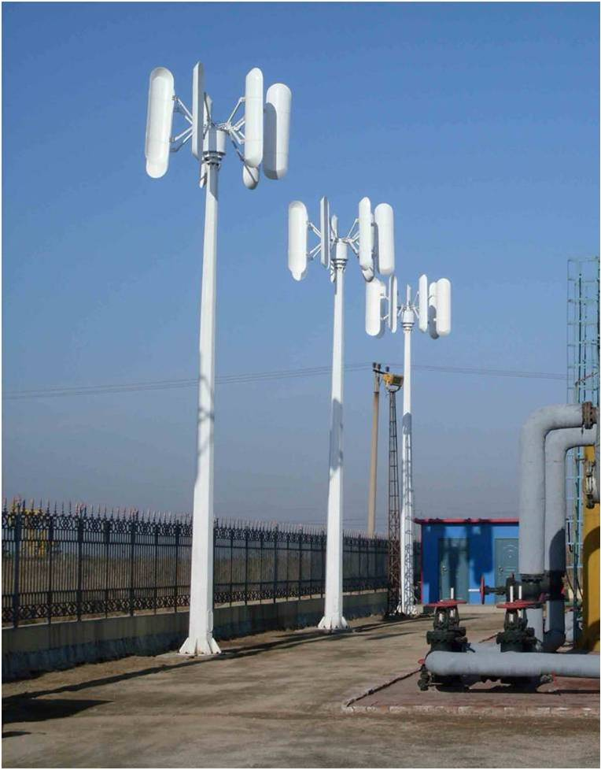
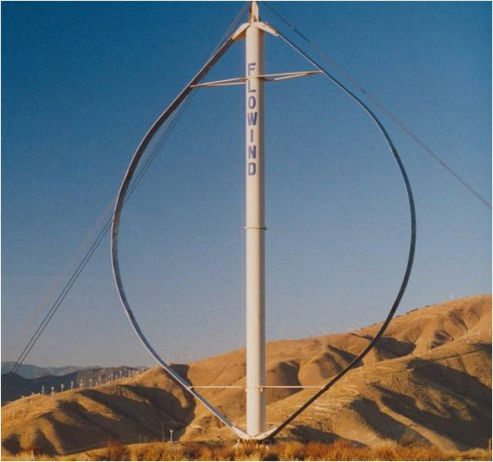
Vertical Axis – More Types
www.symscape.com
image.made-in-china.com
2 kw
A FloWind 19m Darrieus vertical-axis wind turbine
Notes:
Advantages of vertical? Don’t need to be faced into wind.
Left
The “Oval” is an aerofoil (has a plane wing-like shape).
Right
Model VAWT--2kW
Generator style PMG 3 phase AC
Gnerator material NdFeB, F grade copper wire
Blade material FRP
Rated rotate speed 50(r/min)
Rated wind speed 10m/s
Start up wind speed 2.5m/s
Working wind speed 3--25(m/s)
Security wind speed 40(m/s)
Rated power 2KW
Max power 2.5KW
Output voltage(DC) 48V/96V
Battery reference 12v150ah*4/ 12V100ah*8

Slide 6
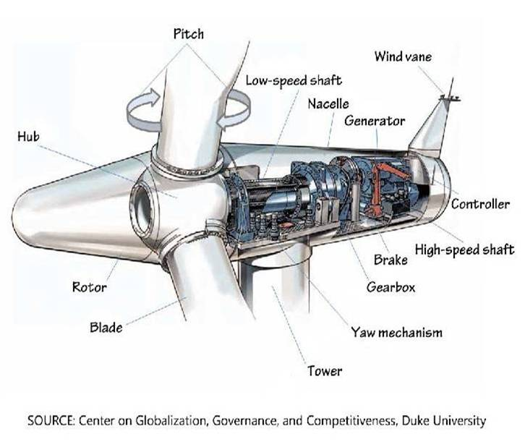
Wind Turbine Parts
www.bls.gov

Slide 7
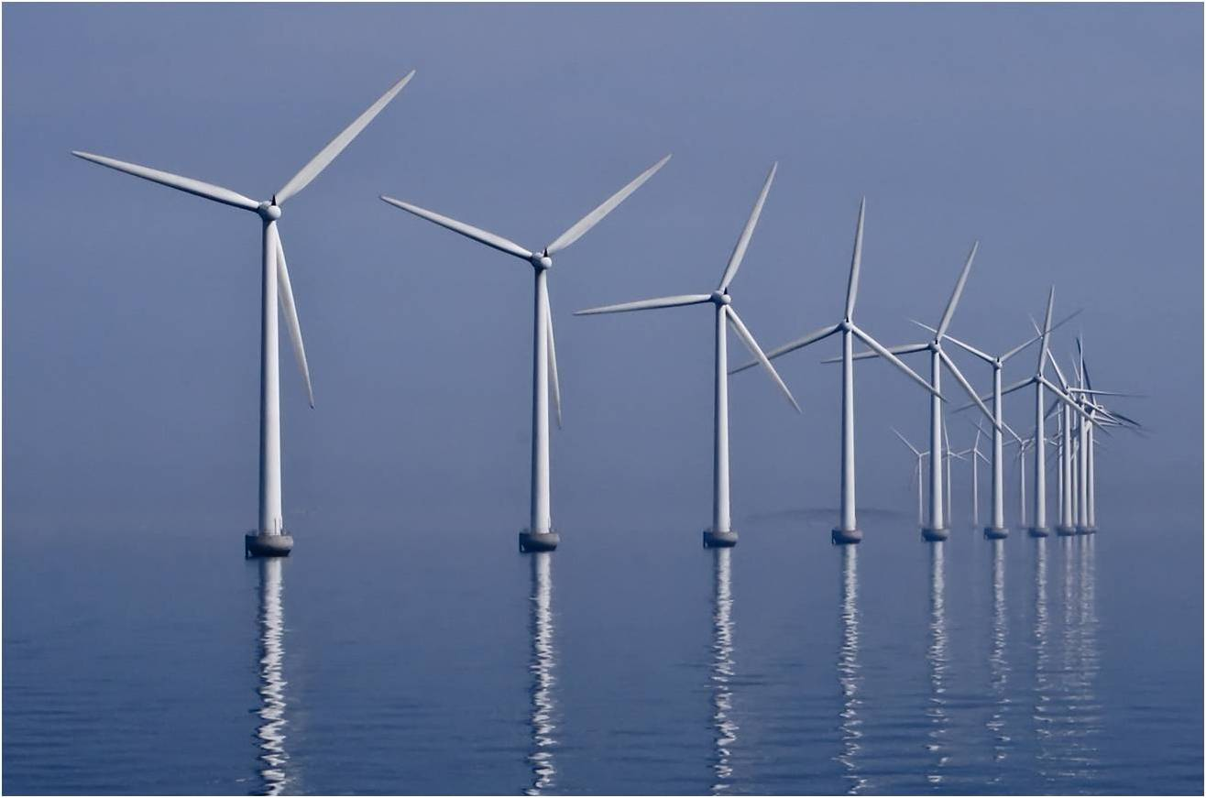
Wind Farm
upload.wikimedia.org

Slide 8
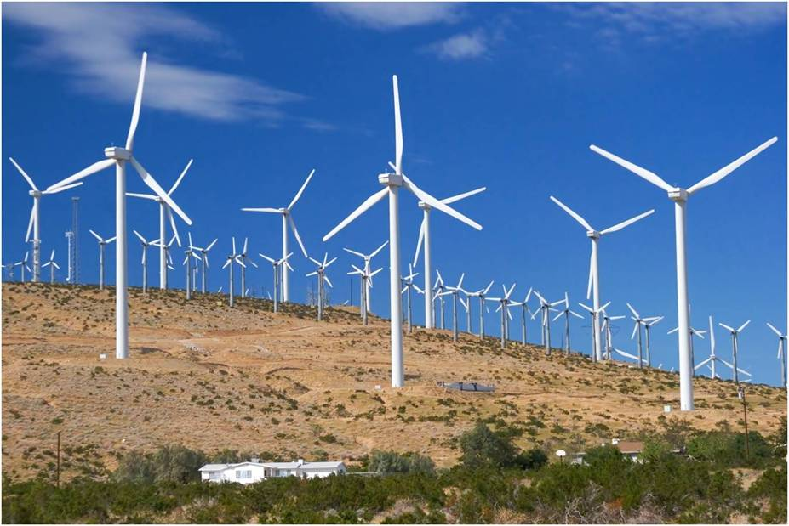
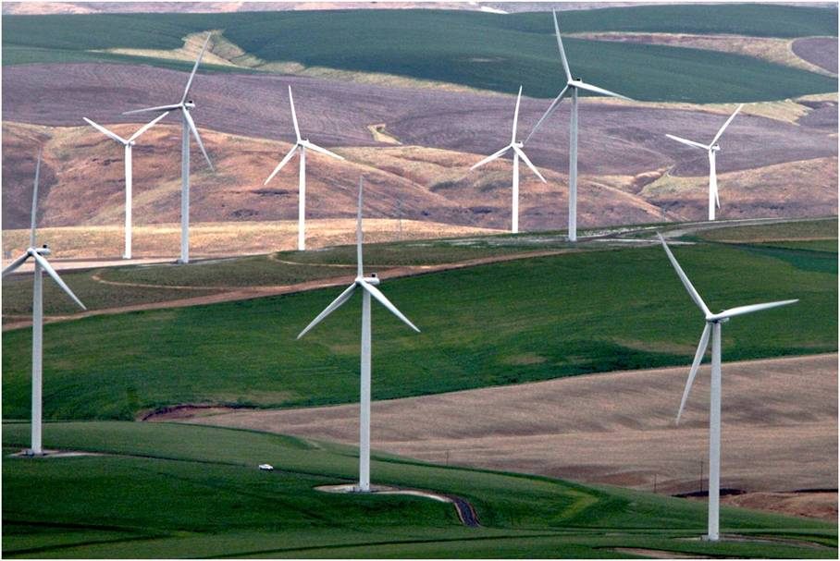
Wind Farms
blog.oregonlive.com
staff.fcps.net
On a Farm →

Slide 9
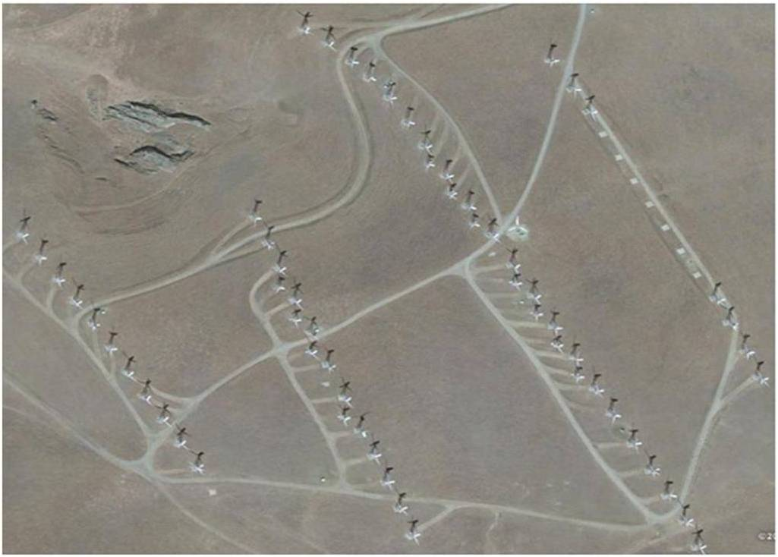
Aerial View
Google map farms
www.masterresource.org
Notes:
Google Maps
Bismarck WV (Ridge)
Alta Wind Energy Center I,II,III,IV,V,VI,VIII^{[3][4][5][6]}1020 California 35°1′16″N 118°19′14″W (desert)
Altamont Pass Wind Farm 606 California 37°43′57″N 121°39′9″W (desert, old style, zoom on Flynn rd)
Blue Creek Wind Farm302 Ohio 41°00′N 84°35′W (Farm, spread out) Note the habitat destruction caused by farms
Crystal Lake Wind Farm 416 Iowa 43°13′45″N 93°50′28″W (Farm, small)
Roscoe Wind Project781^{[34]} Texas 32°15′52″N 100°20′39″W (Farm, sparse)
Windy Point/Windy Flats400Washington45°44′31″N 120°43′32″W (desert)
Kibby Wind Power Project132Maine45°25′07″N 70°32′40″W (Ridge)

Slide 10
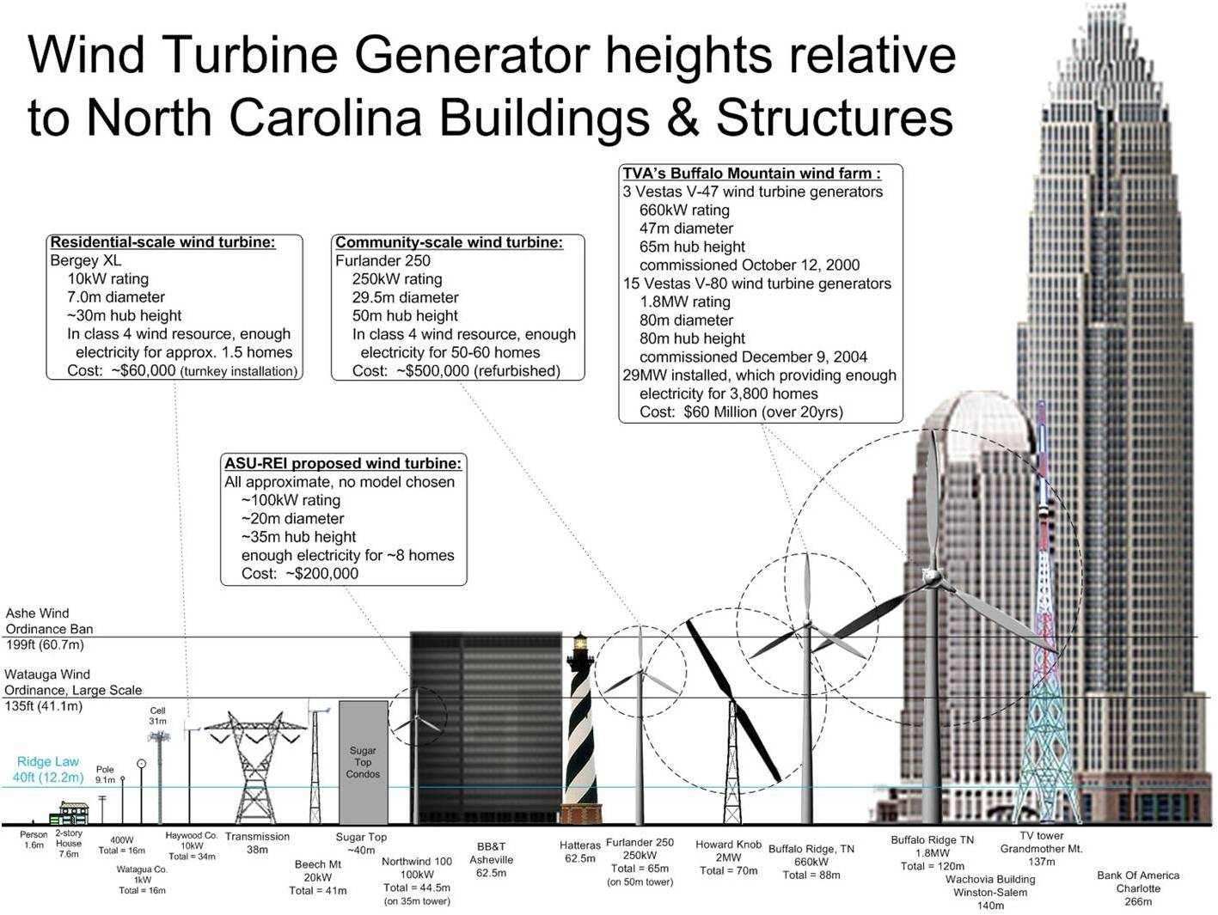
Size
www.appstate.edu

Slide 11
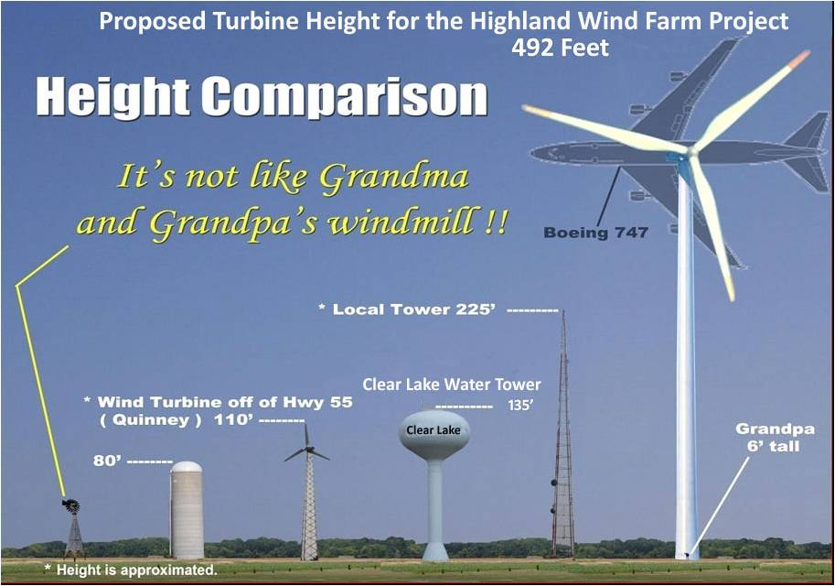
Size
theforestvoice.org

Slide 12
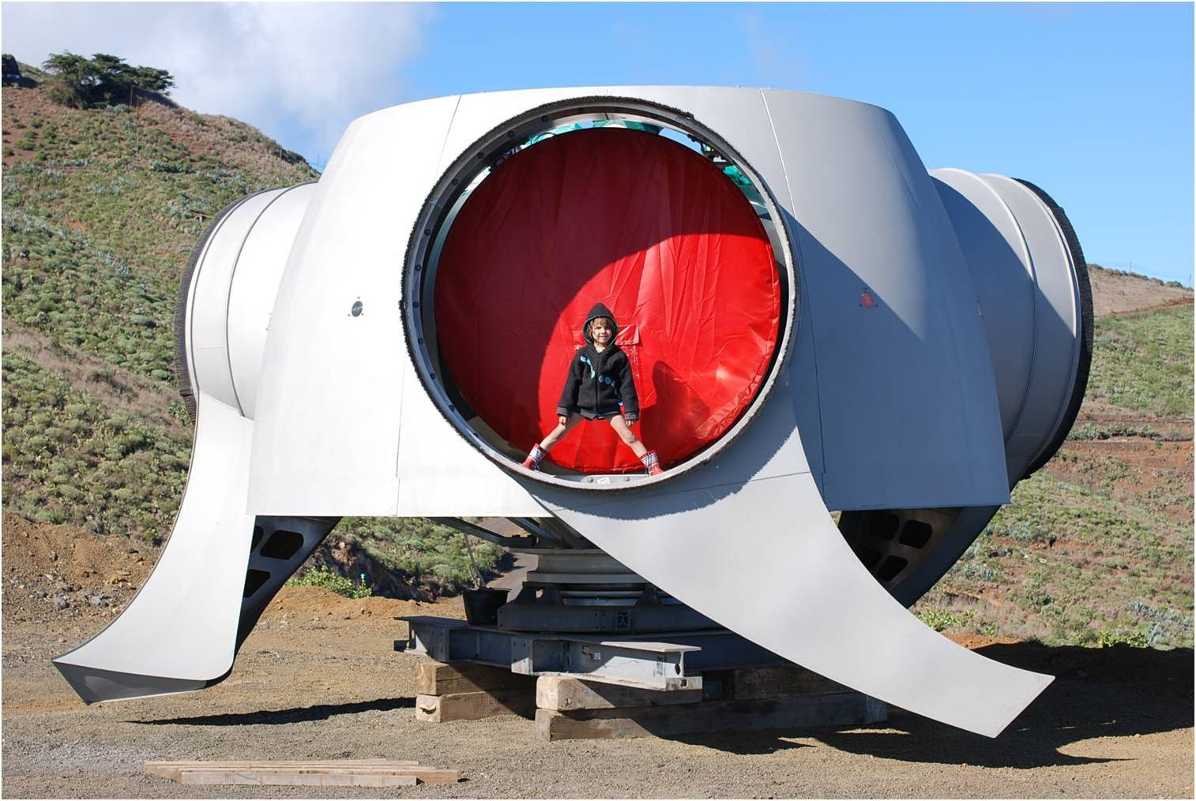
Size
upload.wikimedia.org
Notes:
Size comparison of a five year old child in a wind turbine rotor hub without blades (Enercon E-70) photographed on El Hierro island.
January 2012

Slide 13
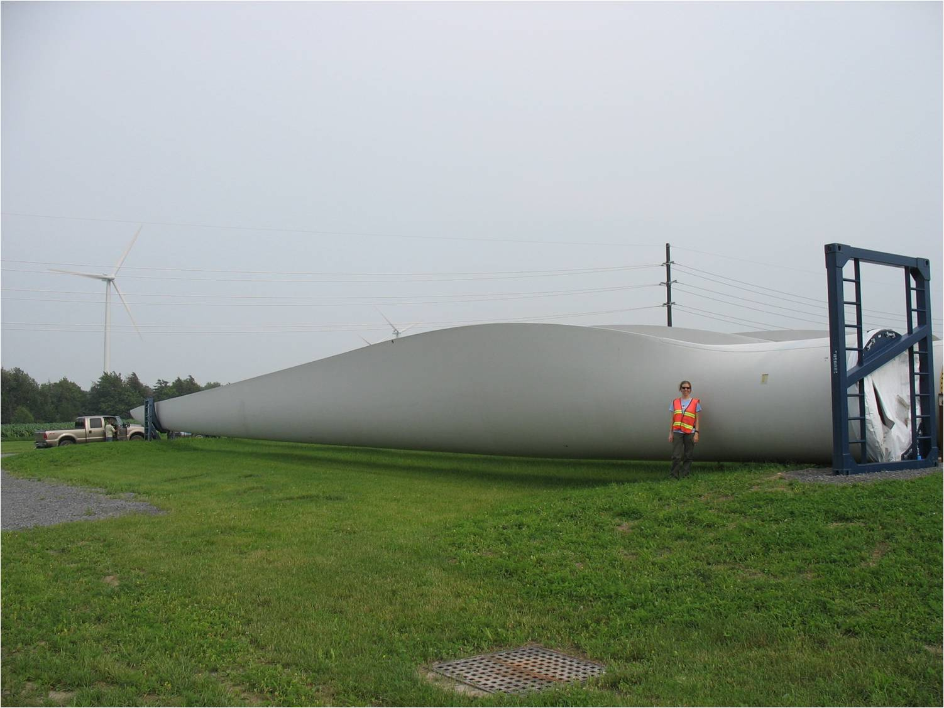
Size
135-ft blade
gallery.usgs.gov
Notes:
Title: Wind Turbine Blade
Description: This photo shows one of the three 135-ft blades of a turbine before installation. Although the blades of wind turbines appear to move quite slowly to the human eye, blade tips often move at speeds faster than 100 mph.
Location: USA
Photographer: Paul Cryan , U.S. Geological Survey

Slide 14
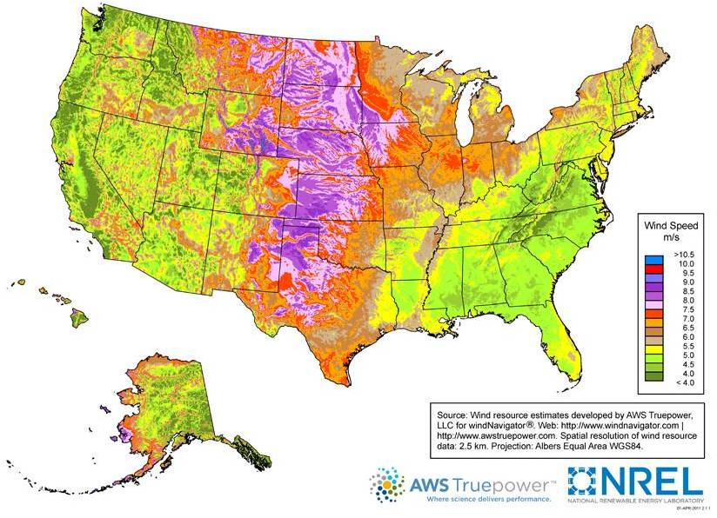
US Wind Map
80-meter (m) height
www.windpoweringamerica.gov

Slide 15
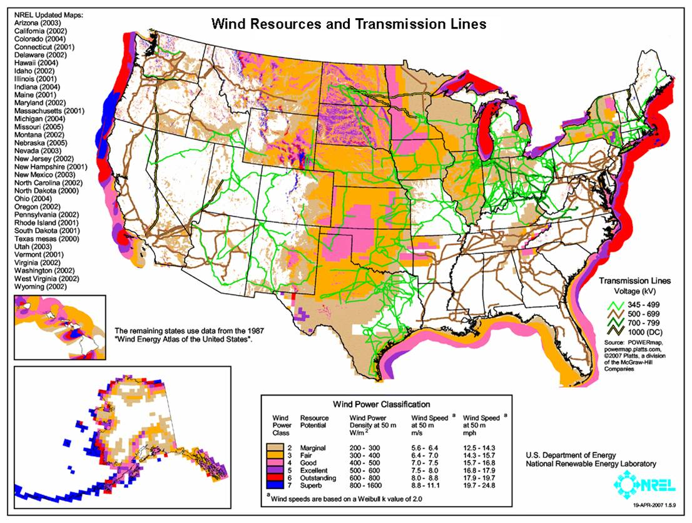
US Wind Map & Transmission
mocoalliance.org

Slide 16
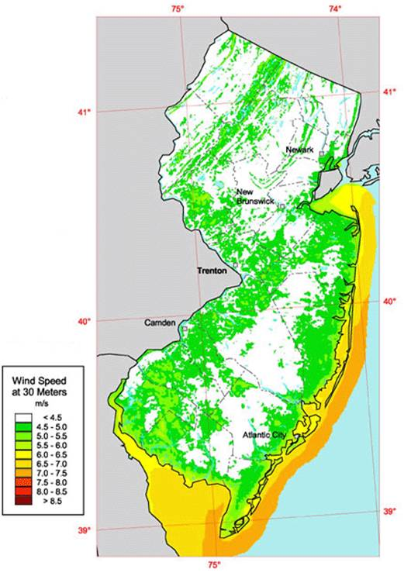
NJ Wind Map
US DOE Map
30 m Wind Height
www.rowan.edu

Slide 17
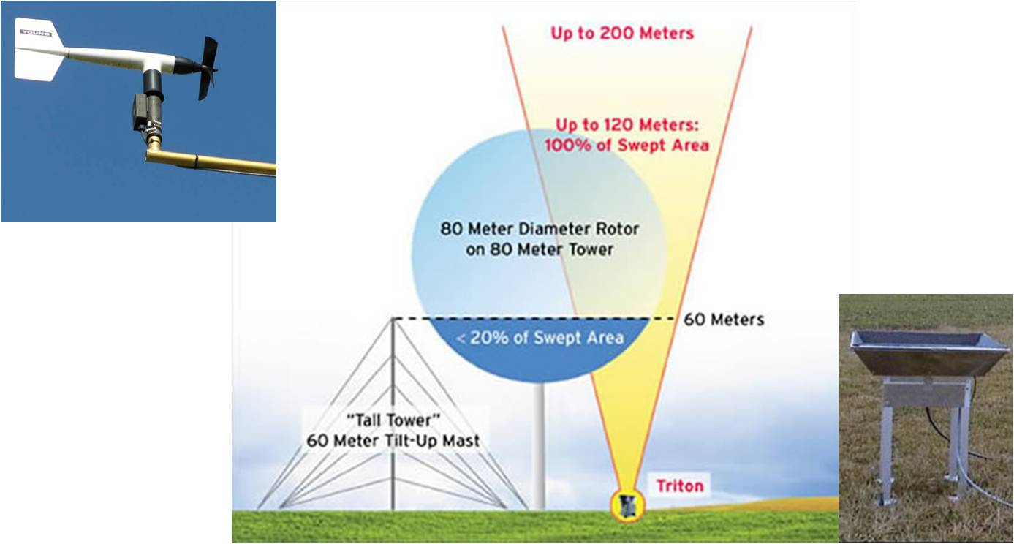
Measuring Wind Speed
Anemometer
Tower
SODAR
www.erh.noaa.gov
www.umass.edu
www.envirotech-online.com

Slide 18
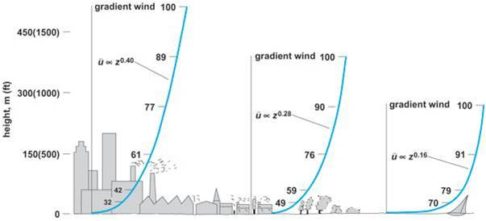
Wind Speed & Height
www.accessscience.com
U = U_{r} (Z/Z_{r})^{α}
  Where U = wind speed, m/s, at wind height Z, m; U_{r} & Z_{r} are a known reference wind speed & height, α = wind power law exponent
    α = 0.11 often used for open water
    α = 0.143 often used for open land
Notes:
Figure 3.Atmospheric boundary-layer profiles (plots of average wind speed u versus height z) over different terrains. Wind speeds are expressed as percentages of the upper-level wind (referred to as the gradient wind) above the boundary (or surface) layer. (After E. J. Plate, Aerodynamic Characteristics of Atmospheric Boundary Layers, AEC Critical Review Series, U.S. Department of Energy, 1971)
From Encyclopedia article 'Environmental fluid mechanics‘
Many other values of alpha can be appropriate for a given location.

Slide 19
Wind Example 1: Height
An Anemometer tower is used to measure the wind speed at 15 m
  The wind speed is 5 m/s
Estimate the wind speed at 30 m
  Assume α = 0.143
Notes:
U = U_{r} (Z/Z_{r})^{α}
U = 5 m/s (30/15)^{0.143} = 5 m/s (2)^{0.143} = 5.5 m/s
(2)^{0.143} = 1.1

Slide 20
Wind Power
P_{w} = 0.5 ρ A V³
  Where P_{w} = power of wind, W; ρ = air density kg/m³; A = Area of wind flow, m²; V = wind velocity, m/s
    W = Watts = N m / s (Newton meter per second)
Theoretical maximum efficiency of wind turbine is 0.59
  Cannot extract all power from wind or it would stop!
  Commercial horizontal axis turbines: 0.3 to 0.4 efficiency
    0.1 to 0.3 if electricity generation & distribution considered
  So Electrical Power from Turbine = ~0.2 P_{w}

Slide 21
Wind Example 2: Wind Power
Given:
  Wind speed, V = 5 m/s
  Blade radius, R = 50 m
  Air density, ρ = 1.1839 kg m⁻³
What wind power passes through area swept by blades?
Notes:
A = π R² = 3.14·50² = 7850 m²
P_{w} = 0.5 ρ A V³ = 0.5·1.1839·7850·5³ = 580,851 W
Units: $\frac{kg }{m^{3}}m^{2}\frac{m^{3}}{s^{3}}=\frac{kg m^{2}}{s^{3}}=\frac{kg m}{s^{2}}\frac{m}{s}=N\frac{m}{s}=W$

Slide 22
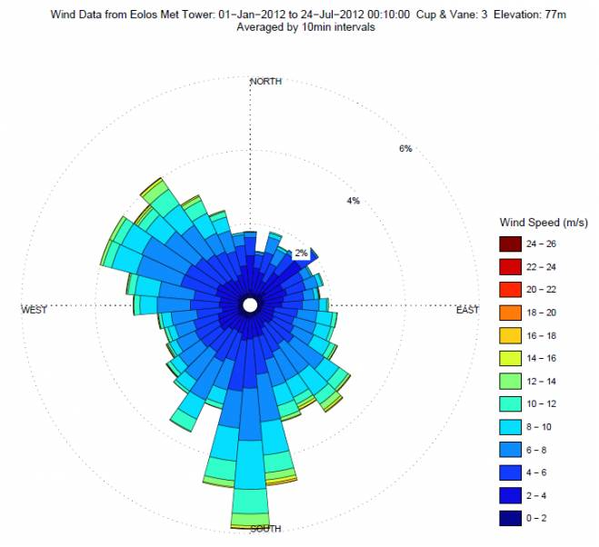
Wind Rose
www.eolos.umn.edu

Slide 23
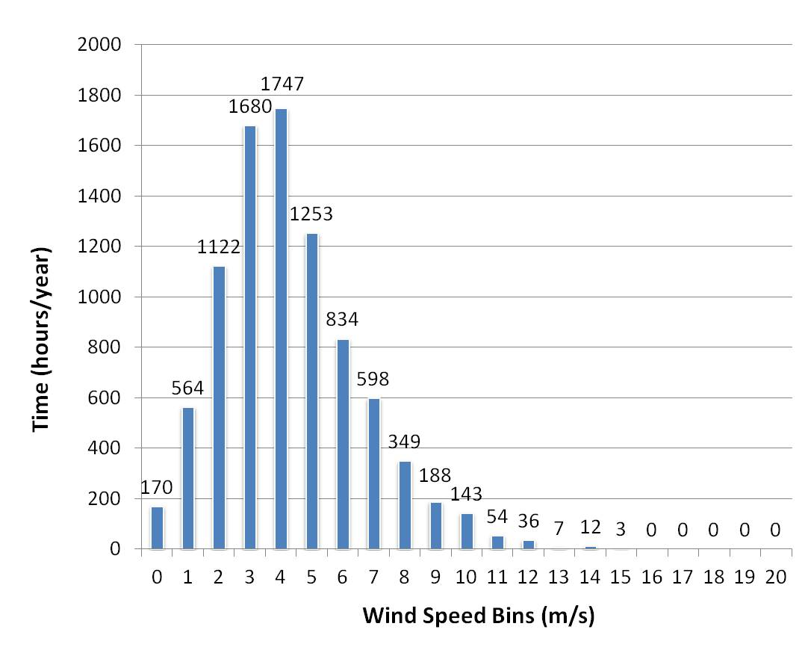
Yearly Wind Distribution
Sea Girt Wind Study, Rowan University

Slide 24
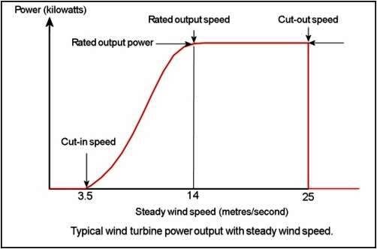
Wind Turbine Power Curve
www.wind-power-program.com

Slide 25
Wind Example 3: Electricity Generation
Wind Speed Bin (m/s) | Hours/Year (From Anemometer Tower) | Power Curve (kW) (Skystream 3.7) | Electricity (kWh)
0 | 170 | 0 | 0
1 | 564 | 0 | 0
2 | 1122 | 0 | 0
3 | 1680 | 0 | 0
4 | 1747 | 0.111 | 194
5 | 1253 | 0.255 | 320
6 | 834 | 0.468 | 390
7 | 598 | 0.757 | 453
8 | 349 | 1.140 | 398
9 | 188 | 1.588 | 299
10 | 143 | 1.990 | 285
11 | 54 | 2.250 | 122
12 | 36 | 2.386 | 86
13 | 7 | 2.430 | 17
14 | 12 | 2.423 | 29
15 | 3 | 2.370 | 7
16 | 0 | 2.308 | 0
17 | 0 | 2.252 | 0
18 | 0 | 2.202 | 0
19 | 0 | 2.154 | 0
20 | 0 | 2.120 | 0
 | Σ = 8760 hrs |  | Σ = 2598 kWh
Notes:
See next slide for calculations

Slide 26
Wind Example 3: Electricity Generation
Wind Speed Bin (m/s) | Hours/Year (From Anemometer Tower) | Power Curve (kW) (Skystream 3.7) | Electricity (kWh)
0 | 170 | 0 | 0
1 | 564 | 0 | 0
2 | 1122 | 0 | 0
3 | 1680 | 0 | 0
4 | 1747 | 0.111 | 194
5 | 1253 | 0.255 | 320
6 | 834 | 0.468 | 390
7 | 598 | 0.757 | 453
8 | 349 | 1.140 | 398
9 | 188 | 1.588 | 299
10 | 143 | 1.990 | 285
11 | 54 | 2.250 | 122
12 | 36 | 2.386 | 86
13 | 7 | 2.430 | 17
14 | 12 | 2.423 | 29
15 | 3 | 2.370 | 7
16 | 0 | 2.308 | 0
17 | 0 | 2.252 | 0
18 | 0 | 2.202 | 0
19 | 0 | 2.154 | 0
20 | 0 | 2.120 | 0
 | Σ = 8760 hrs |  | Σ = 2598 kWh
Column 1 = Wind Speed Bins (0-1 m/s, 1-2 m/s, etc.)
Column 2 = Hours / year wind is within a given Bin (from wind assessment)
Column 3 = Power Curve of Turbine (from Manufacturer or independent study)
Column 4 = Electricity Produced by turbine for each Bin
Notes:
Column 4 = Column 2 x Column 3, e.g., Bin 4: 1747 x 0.111 = 194 kWh
ΣColumn 4 = Electricity produced in a year = 2598 kWh

Slide 27
Wind Example 4:
Sea Girt-Skystream 3.7 Economics
Cost of Skystream 3.7 = $13,300
  Electricity (Skystream at Sea Girt) = 2,600 kWh/yr
  NJ CEP $3.20/kWh rebate = 2,600 kWh · $3.20/kWh = $8,320
  Net cost = $13,300 - $8,320 = $4980
Revenue
  Electricity = $0.12/kWh
  WRECs = $0.05/kWh
  Net Revenue =
Simple payback =
Notes:
CEP = Clean Energy Program
WREC = Wind Renewable Energy Credit
Revenue
Electricity = $0.12/kWh
$0.12/kWh · 2,600 kWh/yr = $312/yr
WRECs = $0.05/kWh
$0.05/kWh · 2,600 kWh/yr = $130/yr
Net Revenue = $312/yr + $130/yr = $442
Simple payback = $4980 / $442/yr = 11.3 yr

Slide 28
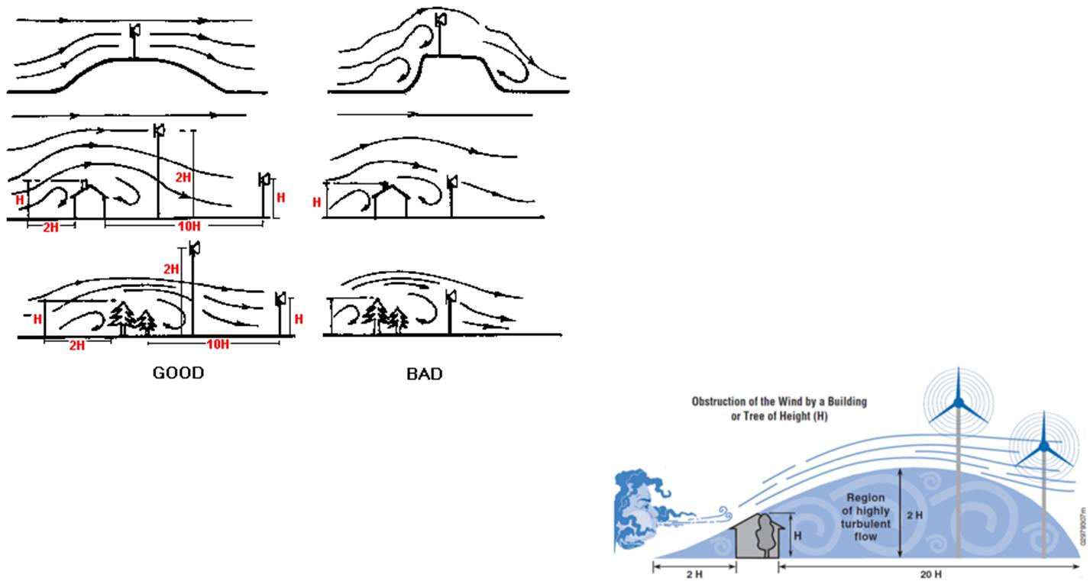
Turbine Siting - Turbulence
www.inforse.org
prod-http-80-800498448.us-east-1.elb.amazonaws.com

Slide 29
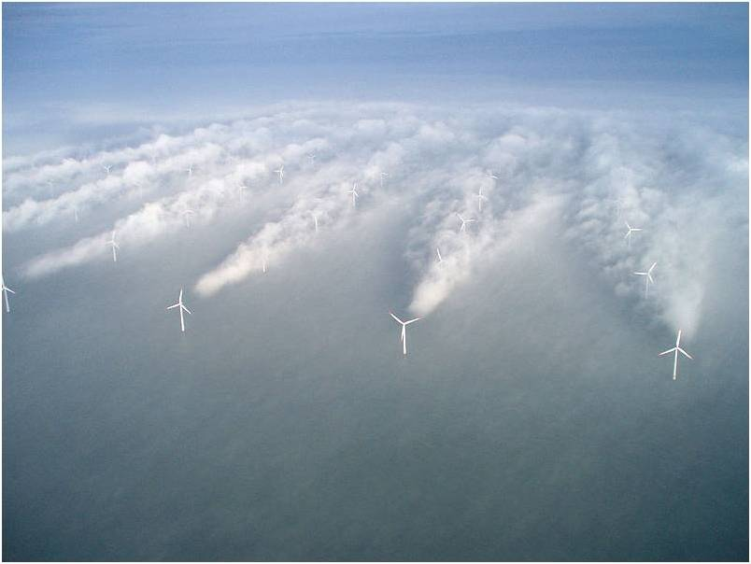
Wake Turbulence
www.nrel.gov
Notes:
Wake turbulence behind individual wind turbines can be seen in the fog in this aerial photo of the Horns Rev wind farm off the Western coast of Denmark. Data collected from wind farms such as this one provide validation to simulation models.
Courtesy of Vattenfall Wind Power, Denmark

Slide 30
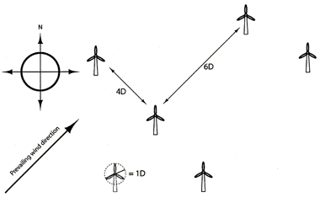
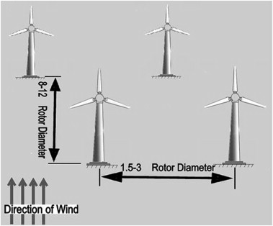
Turbine Spacing - Shadowing
ars.els-cdn.com
www.planningni.gov.uk
Notes:
Draft PPS 18: Renewable Energy
Annex 1 Wind Energy: Spacing of Turbines
A16. Wind turbines need to be positioned so that the distances between them are between 3-10 rotor diameters (about 180-600 metres for a wind farm using 60m diameter, 1.3MW wind turbines) depending on the individual circumstances of the site. This spacing represents a compromise between compactness, which minimises capital cost, and the need for adequate separations to lessen energy loss through wind shadowing from upstream machines. The required spacing will often be dependent on the prevailing wind direction as illustrated in Figure 3 below, which shows a possible layout for a site in Northern Ireland with a typical South Westerly prevailing wind direction.
Figure 3
Example turbine spacing in a wind farm with a South Westerly prevailing wind direction
A17. Bearing in mind the requirements for optimal performance, a distance of not less than two rotor diameters from adjoining property boundaries will generally be expected, unless there is written agreement of adjoining landowners to a lesser distance.

Slide 31
Environment / Safety Issues
Habitat Disruption
Bird Mortality
Bat Mortality
Noise
Flicker
Blade Throw, Ice Throw, Tower collapse

Slide 32
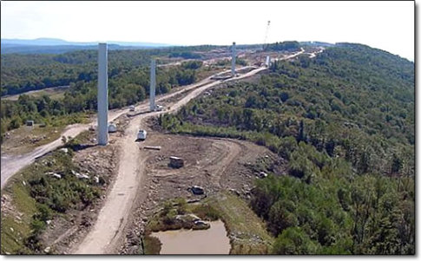
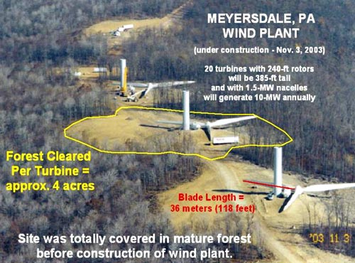
Habitat Destruction
betterplan.squarespace.com
johnrsweet.com
Notes:
Left picture is backbone mounting, tucker county wv

Slide 33
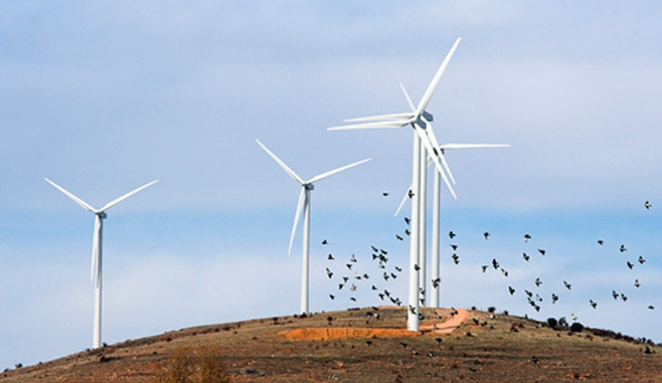
Birds
www.earthtimes.org

Slide 34
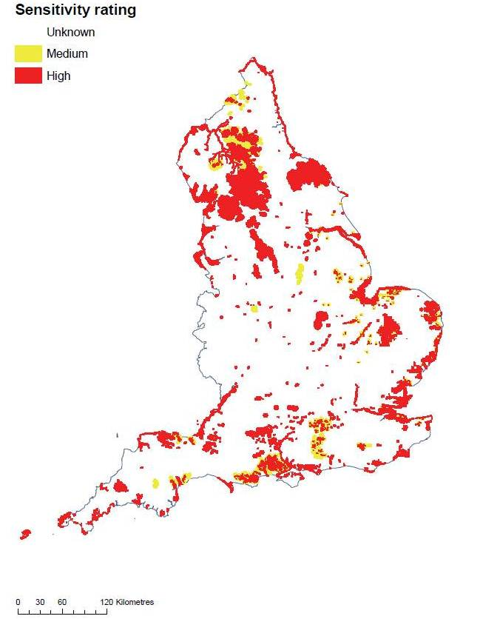
UK sensitive bird areas
www.rspb.org.uk
Notes:
Figure 1. Map of sensitive bird areas in relation to onshore wind farms in England.
Based on the highest sensitivity rating, for any of the species or sites included, in each constituent 1-km square.
www.rspb.org.uk
Mapped and written
guidance in relation to birds
and onshore wind energy
development in England
J. A. Bright1, R. H. W. Langston1*, S. Anthony2
1RSPB, The Lodge, Sandy, Bedfordshire SG19 2DL
2Natural England, 6th Floor, Ashdown House,
123 Victoria Street, London SW1E 6DE
1*Rowena.Langston@rspb.org.uk
RSPB Research Report No 35

Slide 35
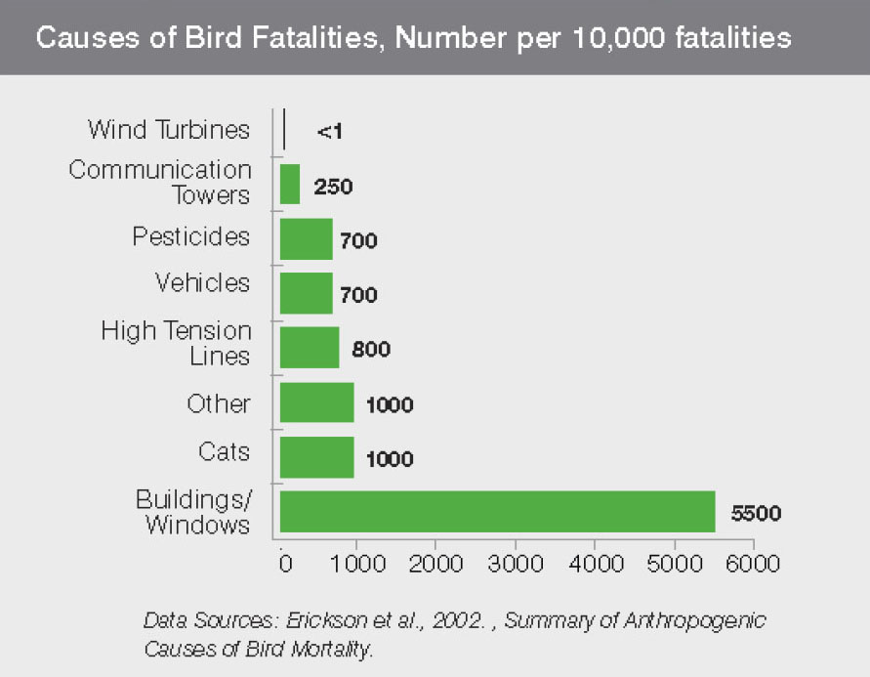
Birds
www.abovetopsecret.com
Notes:
How many turbines installed when study done?
350 M birds killed per year by house cat

Slide 36
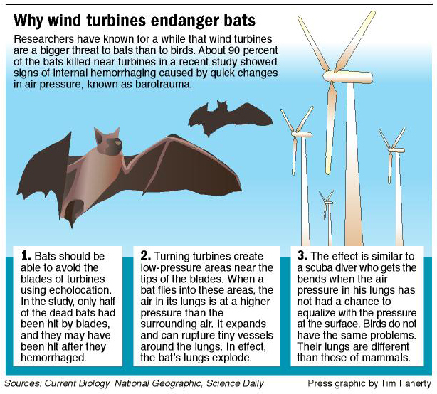
Bats
betterplan.squarespace.com

Slide 37
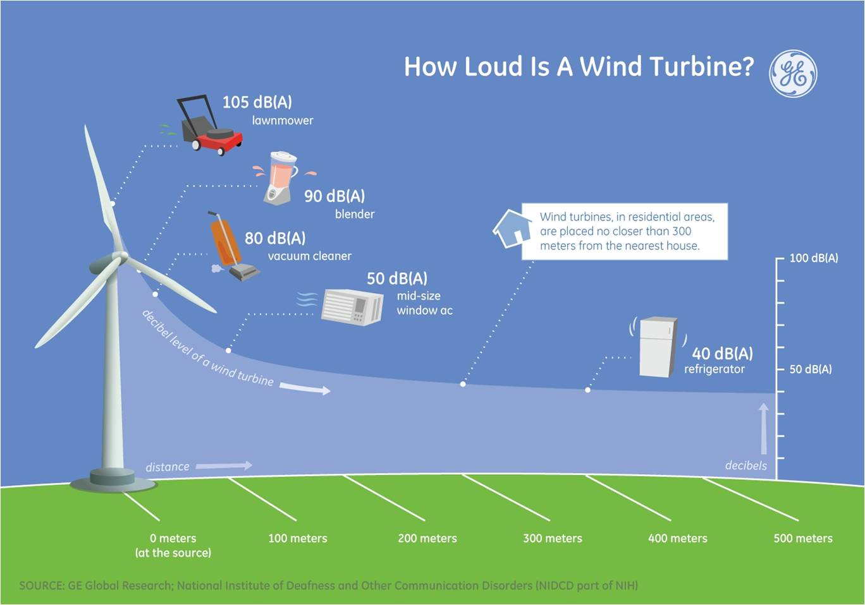
Noise
mikechristie.files.wordpress.com

Slide 38
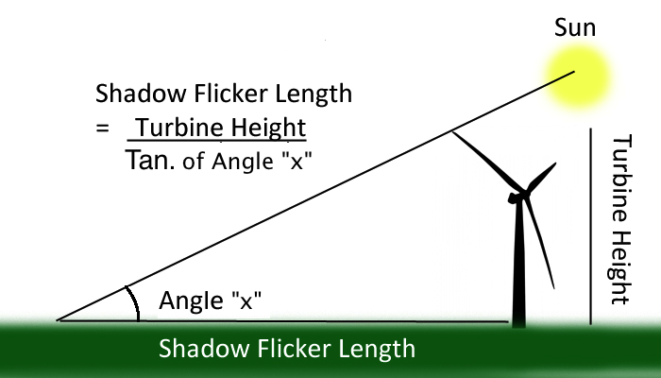
Shadow Flicker
quixoteslaststand.com
Notes:
More of a problem in Europe, with lower sun angles than US

Slide 39
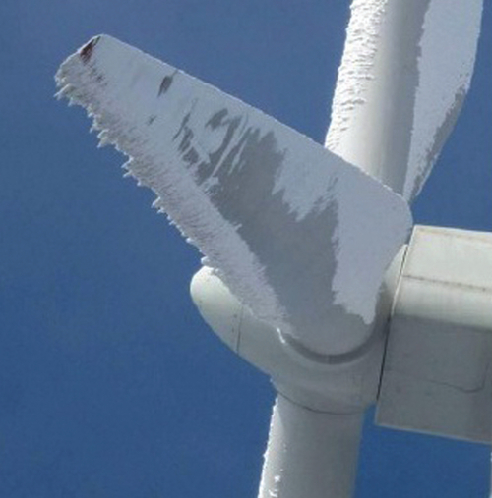
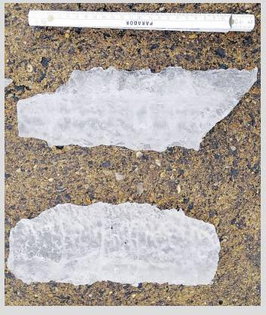
Ice Throw
wpcore.wpe.s3.amazonaws.com
www.wind-watch.org

Slide 40
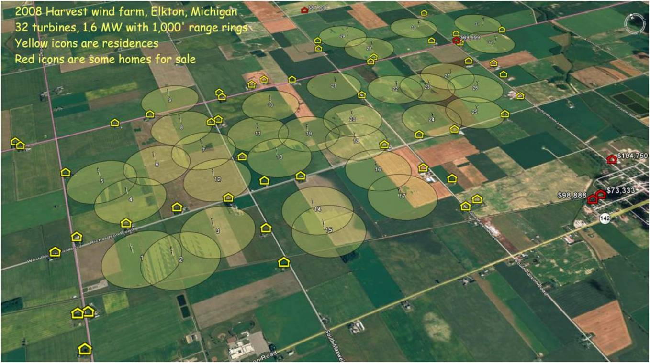
Buffers
www.thumbpower.net
Notes:
Here is a map of the Elkton wind farm. It appears the designers of the project often took full advantage of the 1000' foot zoning setback from homes for nothing more than reducing the cost of access roads and transmission lines. Here is the Google Earth kmz file that was made for the photo below. Download and save with a kmz extension and it will load directly into GE by double clicking the file name, assuming Google Earth is installed on your computer. Harvest Wind Farm Site Layout plus residences for Google Earth (kmz 68KB) You can also see residences listed for sale, or lack of them, around Harvest wind farm updated real time on Google Earth. Download this file and run it in Google Earth for listings updated automatically. Trulia.com real time residential real estate listings for Huron County (kmz 1KB)
www.thumbpower.net

Slide 41
Buffer Zones
Ice Throw
  1.5 * (hub height + rotor diameter)
Tower Collapse
  110 % of max height (to tip of blade pointing straight up)
Rotor Fragmentation
Noise (Germany)
  “quiet regions” [35 dB(A)]: 1,000-1,500 m (3,281-4,921 ft)
  “middle regions” [(40 dB(A)]: 600-1,000 m (1,969-3,281 ft)
  “standard region” [(45 dB(A)]: 300-600 m (984-1,969 ft)
Flicker
  Typical Buffers, Vegetative Buffers
  Site specific determination of incidence of flickering
Birds & Bats
  0.25 to 0.5 miles from nesting areas?
  500 m? 800 m?
Notes:
Ice Throw - GE Energy David Wahl Philippe Giguere Wind Application Engineering GE Energy Greenville, SC
Noise - GERMANY
Different setbacks apply according to the noise level protection of the area :
- “quiet regions” [35 dB(A)]: 1,000-1,500 m (3,281-4,921 ft)
- “middle regions” [(40 dB(A)]: 600-1,000 m (1,969-3,281 ft)
- “standard region” [(45 dB(A)]: 300-600 m (984-1,969 ft)
European Platform Against Windfarms 2009 “European Setbacks (minimum distance between wind turbines and habitations)” www.wind-watch.org
Flicker (www.awea.org/learnabout/publications/upload/Wind-Turbines-and-Health-Factsheet_WP11.pdf)
Shadow flicker occurs when the blades of a turbine pass in front of the sun to create a recurring shadow on an
object. Computer models in wind development software can determine the days and times during the year that
specific buildings in close proximity to turbines may experience shadow flicker. Mitigation measures can be taken
based on this knowledge and may include setbacks or vegetative buffers. Issues with shadow flicker are less
common in the United States than in Europe due to the lower latitudes and the higher sun angles in the U.S.
Birds
Montana wind farm considers bigger bird buffer
Credit: Written by KARL PUCKETT, www.greatfallstribune.com 9 March 2012 ~~
The developer of a commercial wind farm planned in an area of northwest Montana with a high density of hawks and eagles is evaluating 11th-hour design changes that would move several turbines at least a half-mile from nests.

Slide 42
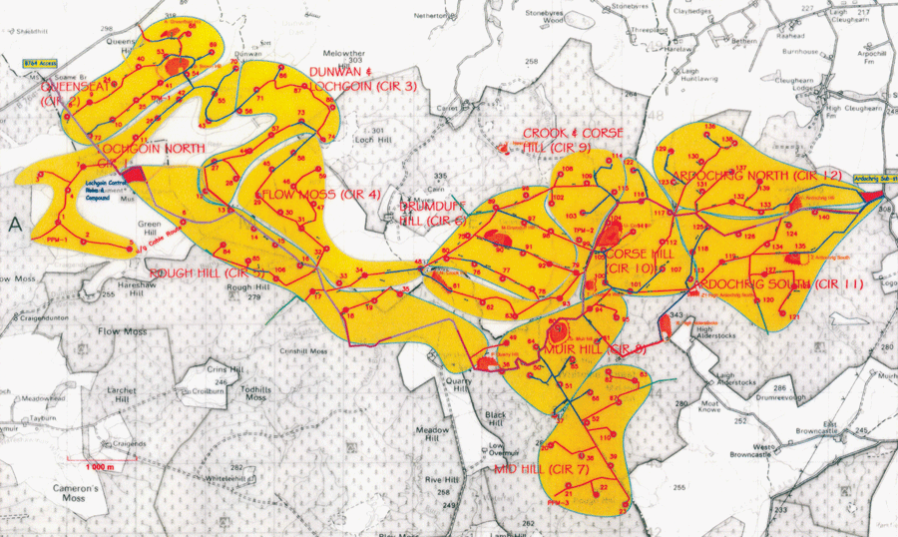
Wind Farm Site Plan
www.building.co.uk
Notes:
Whitelee wind farm: Putting the wind up
2008 Issue 14

